Slide 1
‘Biometrics and Policing in an AI-Driven World’ Dr Brian Plastow – Scottish Biometrics Commissioner
PRESENTERS NAME

Slide 2
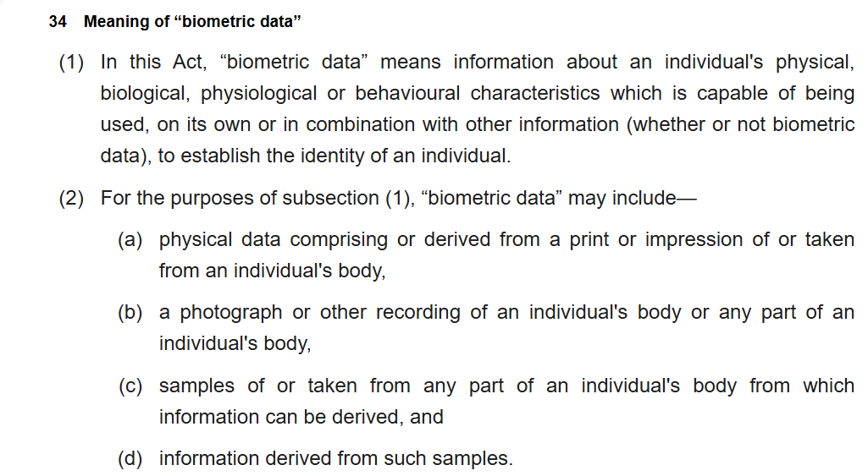

Slide 3
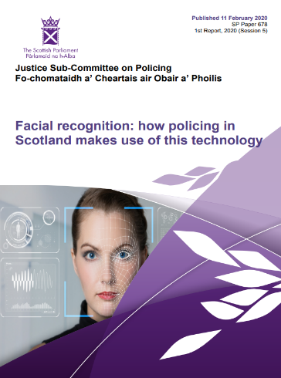
Why the Scottish Parliament wanted oversight of biometrics under Scottish criminal procedure law.

Slide 4
Parliament approves Scottish Biometrics Commissioner Act 2020
Function of Commissioner is to support and promote lawful, effective, and ethical use under Scottish criminal procedure law.
Scottish legislation is intended to be complimentary to reserved UK legislation (for example UK data protection law, UK CT laws, or UK investigatory powers legislation.
Scottish legislation applies to the biometric data and to the source materials
Scottish Parliament approved statutory Code of Practice to help promote good practice and maintain public confidence and trust.

Slide 5
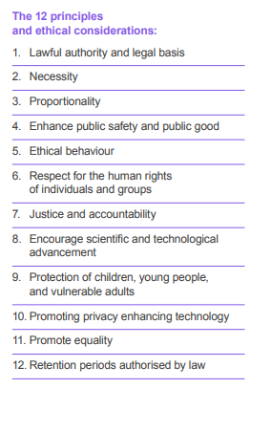
Code of Practice

Slide 6
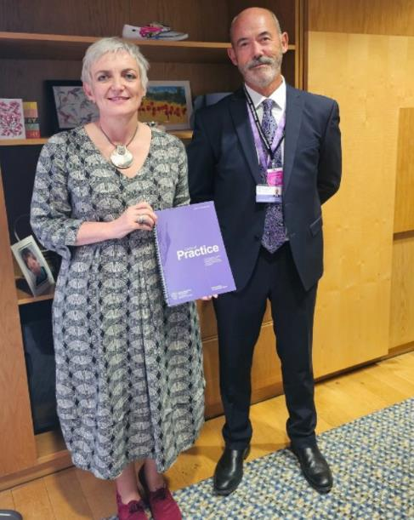
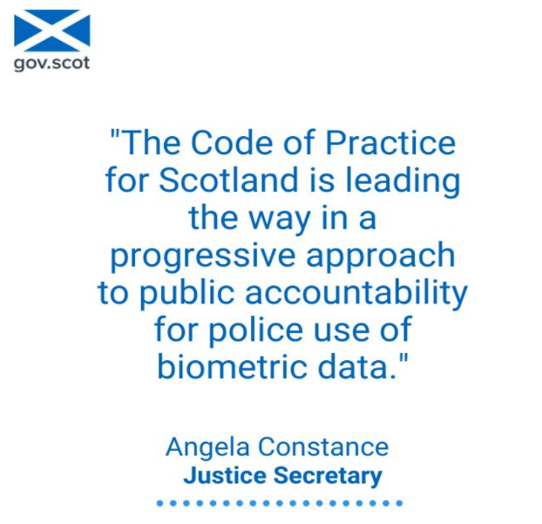

Slide 7
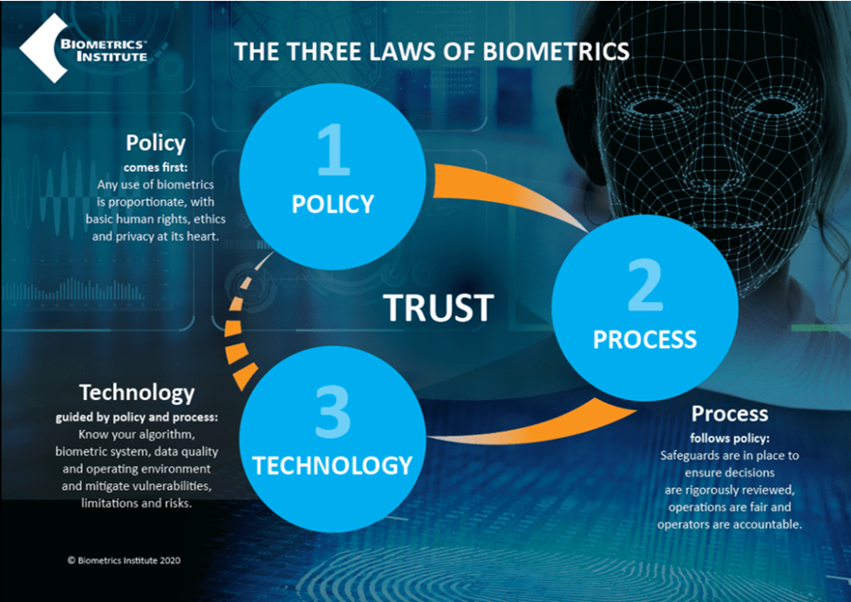

Slide 8
Policy comes first

Slide 9
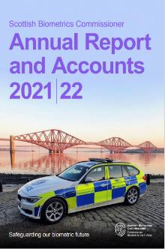
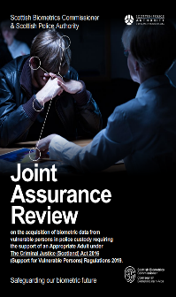
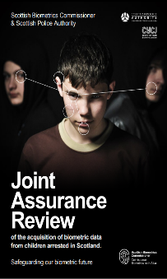
Process follows Policy

Slide 10
Technology comes last:
Police Scotland awards £13.3 m for body worn video (BWV) contract after consultation reveals public support.
Scotland starts national conversation on live facial recognition

Slide 11
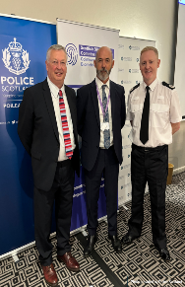
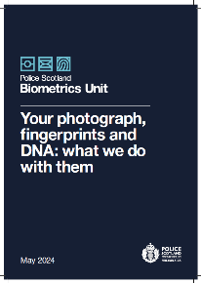
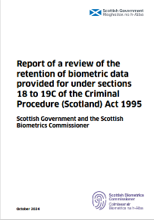
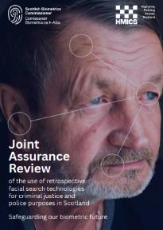
Where are we now?

Slide 12
Biometrics held by UK police
7 million DNA profiles
8 million fingerprint templates
Over 20 million facial image templates
National Security Determinations
Covert policing solutions
Macrovector on Freepik

Slide 13
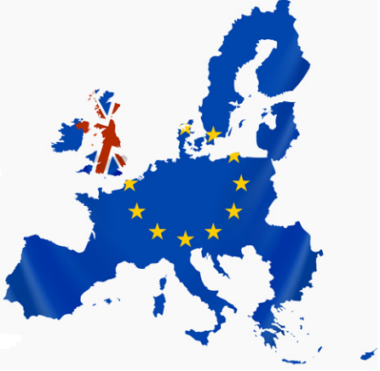
Biometric exchanges with European Union
Exchanges between UK and 27 member countries (514 million population)
Exchanges between UK and Interpol
Prüm Convention and Prüm 2
Disrupts and detects international criminality
PRESENTERS NAME

Slide 14
UK Policy in next 5 years
Deliver single UK custody image database
Increase the effectiveness of retrospective facial search
More adoptions of live facial recognition
Prepare for Prüm 2
More inter-agency sharing of biometrics
Strengthen international exchange agreements

Slide 15
UK Child Abuse Image Database
Secure national database of images, videos and metadata of illegal Child Sexual Abuse Materials acquired by UK police and the National Crime Agency (NCA)
International Law Enforcement Agencies (LEAs) – LEAs from around the world, in particular the Five Eyes countries (United States, Canada, New Zealand and Australia) work closely to collaborate on developing new tools, share data and knowledge.
Identifies illegal content and offenders
Removes illegal content
Keeps children safe

Slide 16
UK law enforcement needs in next 5 years
Better retrospective facial search solutions
Live facial recognition
Mobile view & enrolment solutions
AI enabled Digital Forensics
Rapid DNA
Voice recognition
Non-generative AI for categorization, weeding and redaction.

Slide 18
Thank You for listening

